Slide 1

Introduction to ML/DL
1
Basics of Machine Learning

Slide 2
1.1
What is Machine Learning?

Slide 3
An intuitive understanding of Machine Learning (ML)
ML is branch of Computer Science
It focuses on the use of data and algorithms to imitate the way humans learn
1.1. What is Machine Learning? Read more: IBM: Machine Learning

Slide 4
How do humans learn?
Humans see data, lots of data
Over a long period of time, a ton of data is processed
Humans start to form bits and pieces of rules based on their observations to understand things
Example:
4 legged furniture?
If I can sit on it: It’s a chair
If I can lie down on it: It’s a bed
1.1. What is Machine Learning?

Slide 5
Computers learn in the same way
Provide a computer lots of data
Select a learning algorithm for it to use
It will form its own rules to solve the problem
1.1. What is Machine Learning?

Slide 6
Purpose
Machine Learning is an important field of data science
There is too much data in the world for humans to process
Machines Learning to do our task is the future
1.1. What is Machine Learning?

Slide 7
Industrial Scale of Data:
400 hours of video are uploaded every minute on Youtube (Source)
192,200 hours of video in 8 hours
YouTube wants to ensure the videos have no offensive content
Human labor is not as efficient at this scale
Solution:
Teach a computer what counts as offensive
The computer automatically flags content
1.1. What is Machine Learning?

Slide 8
1.2
What is Deep Learning?

Slide 9
Machine Learning vs Deep Learning
Classical Machine Learning is dependent on human intervention
Human experts determine the set of features to learn
Can do supervised learning
Deep Machine Learning can work with or without human intervention
Human experts could determine the set of features to learn but not required
Can do supervised & unsupervised learning
1.2. What is Deep Learning? Read more: IBM: Deep Learning

Slide 10
Artificial Intelligence vs Machine Learning vs Deep Learning
AI (Artificial Intelligence) - is an umbrella term for software that mimics human cognition to perform complex tasks
ML (Machine Learning) - sub-field of AI that uses algorithms trained on data to produce adaptable models to perform tasks
DL (Deep Learning) - subset of machine learning that uses layers of Neural Networks to do the most complex ML tasks
1.2. What is Deep Learning? Read more: AI vs ML vs DL

Slide 11
1.3
How do Machines Learn?

Slide 12
All Machine Learning tasks has 3 general steps
Decision: ML algorithms are used to either make a prediction or classify a given data input. The data may or may not be labeled
Error Function: A function is responsible to evaluate the prediction of a model with it’s true label
Optimization: Models are adjusted to reduce discrepancy between a known example and the model estimate
1.3. How do Machines Learn? Read more: IBM: How Models Learn

Slide 13
Types of Learning
Machines can be taught with 3 different methods:
Supervised Learning
Unsupervised Learning
Reinforcement Learning
1.3. How do Machines Learn? Read more: IBM: Learning Methods

Slide 14
Supervised Learning
This is the most popular method to train algorithms.
A labeled dataset is used to train algorithms
The algorithm learns patterns from labeled data during training and predict outcomes for new, unseen data
Can be used to learn classification or regression
Trained models aim to generalize, by avoiding overfitting/underfitting (cont. next slide)
1.3. How do Machines Learn?

Slide 15
Generalization: Model should generalize by learning the underlying patterns in the data, rather than memorizing the data exactly
Overfitting: Occurs when a model fits the training data too closely and can only train well but test poorly. Model has memorized data
Underfitting: Occurs when the model is too simple and has not captured the underlying pattern. Model did not learn
1.3. How do Machines Learn?

Slide 16
Example of models that are used during supervised learning:
Neural Networks
Naive Bayes
Random Forest
Gradient Boosting
And many more!
1.3. How do Machines Learn?

Slide 17
Unsupervised Learning
An unlabeled dataset is used to train algorithms
Used often to uncover hidden patterns or data grouping without human intervention
Ideal for:
Exploratory data analysis
Image and Pattern Recognition
1.3. How do Machines Learn?

Slide 18
Example of models that are used during unsupervised learning:
Neural Networks
K-means clustering
Principal Component Analysis (PCA)
Singular Value Decomposition (SVD)
1.3. How do Machines Learn?

Slide 19
1.4
AI is already everywhere

Slide 20
Speech Recognition
A lot of programs allow users to speak instead of typing
This increases a program’s accessibility to the differently abled
Also allows for a more natural interaction with computers
Examples:
Google Assistant
Speech-to-Text keyboards
1.4. AI is all around us. Read more: IBM: The use-cases of AI

Slide 21

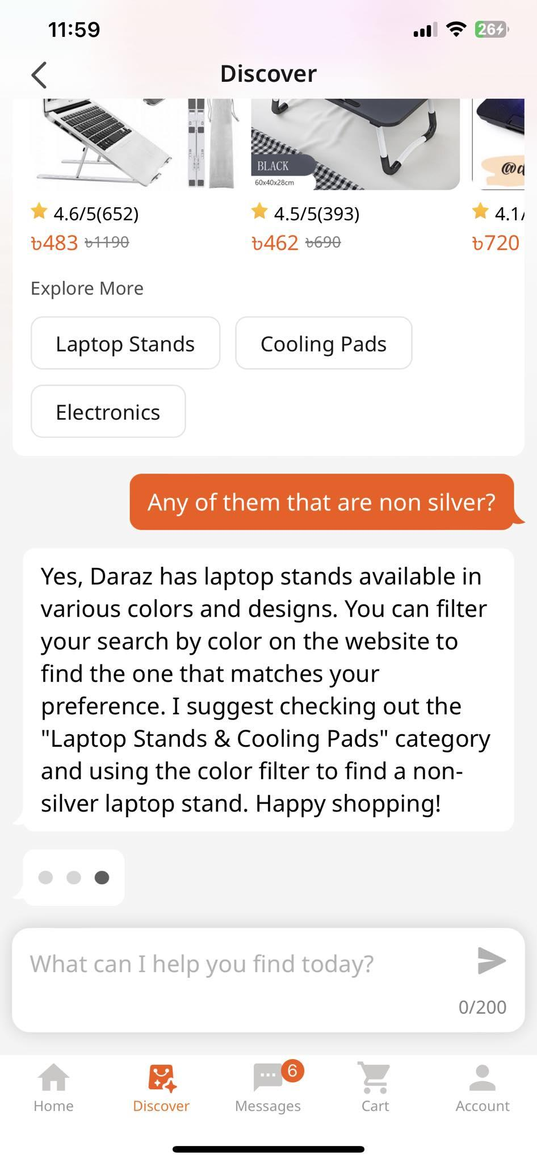
Customer Service
The advent of ChatGPT and other chatbots have led to creation of customer service chatbots
Daraz has rolled out their own chatbot to help you search for items
1.4. AI is all around us. Read more: IBM: The use-cases of AI

Slide 22
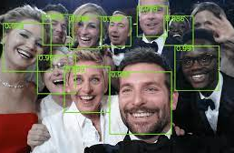
Computer Vision
Everytime you take a picture, AI is used to determine the best way to tune color, exposure and lighting
MKBHD talks about this with examples
When the picture is taken, AI is used to tag faces in the picture for various reasons
1.4. AI is all around us. Read more: IBM: The use-cases of AI

Slide 23
Recommendation Engines
Using past customer data, AI models can help recommend content that customer likes to consume
TikTok, Youtube, Instagram, Facebook, etc. perfected the craft
Advertisement platforms are built with the promise of connecting the right ads to the right user
1.4. AI is all around us. Read more: IBM: The use-cases of AI

Slide 24
Fraud Detection
Banks and other financial institutions use AI to spot suspicious transaction
This is to protect their customers from malicious intent
Email services also detect and delete fraudulent emails from entering your inbox
1.4. AI is all around us. Read more: IBM: The use-cases of AI

Slide 25
END.

